Slide 1
Machine Learning
Polynomial Regression
Kingston Hurt

Slide 2
Algorithm:
1
Model
2
Error & Loss Function
3
Updating Weights
4
Training
5
Prediction
6
Developments

Slide 3
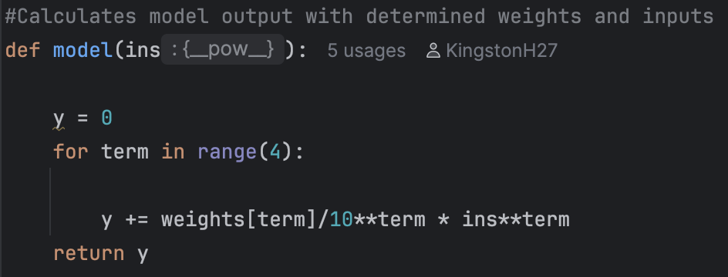
Model
Polynomial Model:
b +
W₁ / 10 * x¹ +
W₂ / 100 * x² +
W₃/1000 * x³

Slide 4
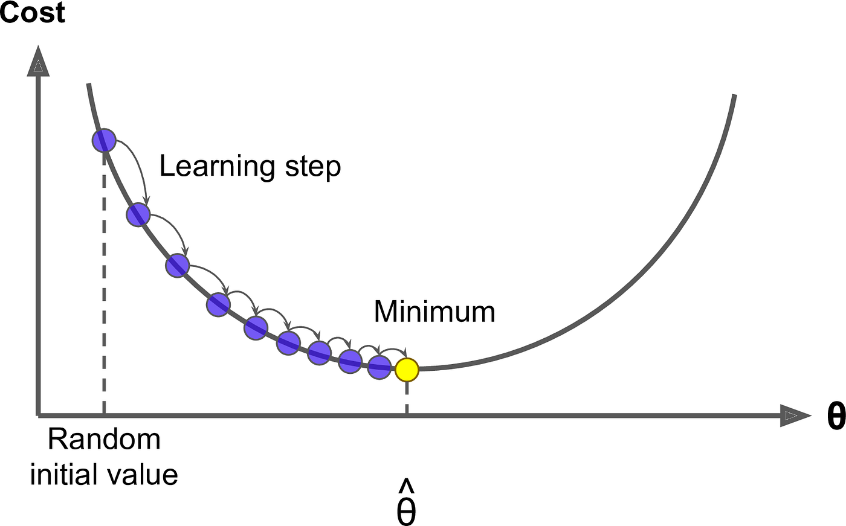
Error and Loss Function
Squared error loss function

Slide 5
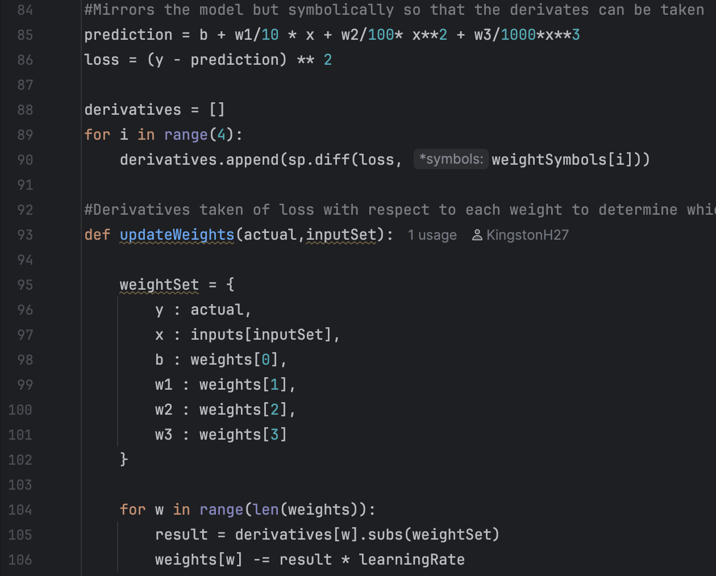
Updating Weights
d/dw_{x} Loss
Derivative of Loss with respect to each weight
Gradient descent

Slide 6
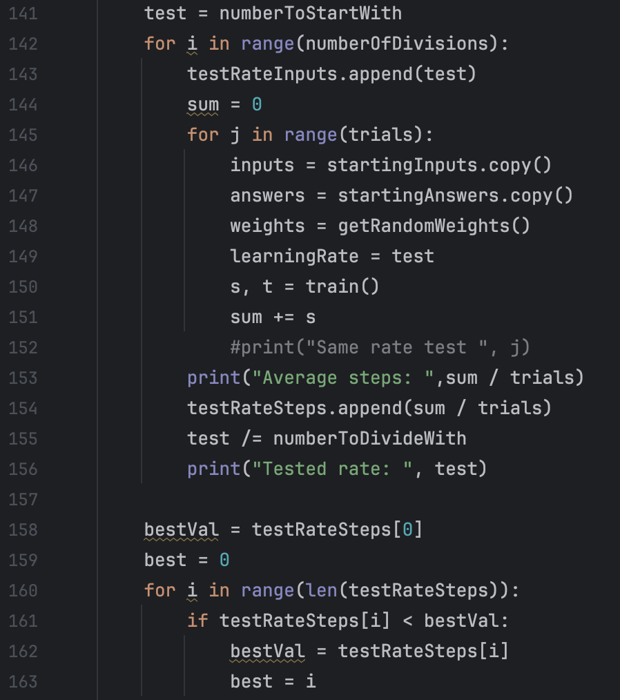


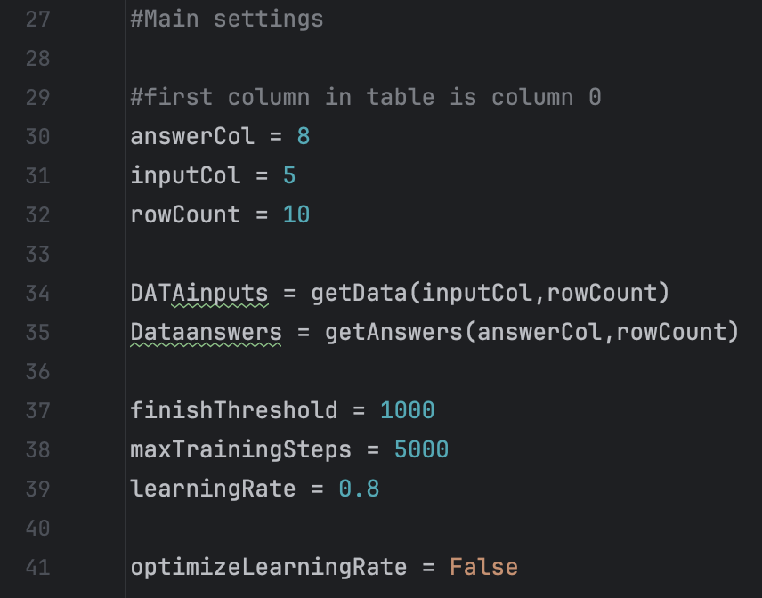

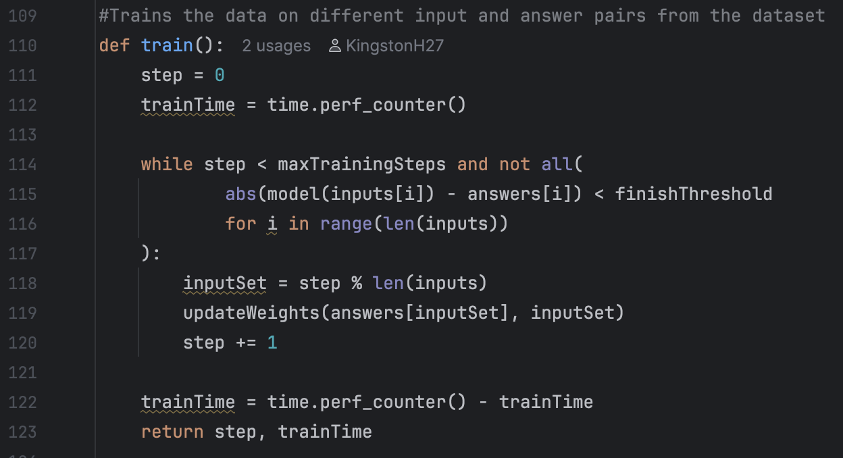
Training
Training loop and end conditions
Find best learning rate function

Slide 7

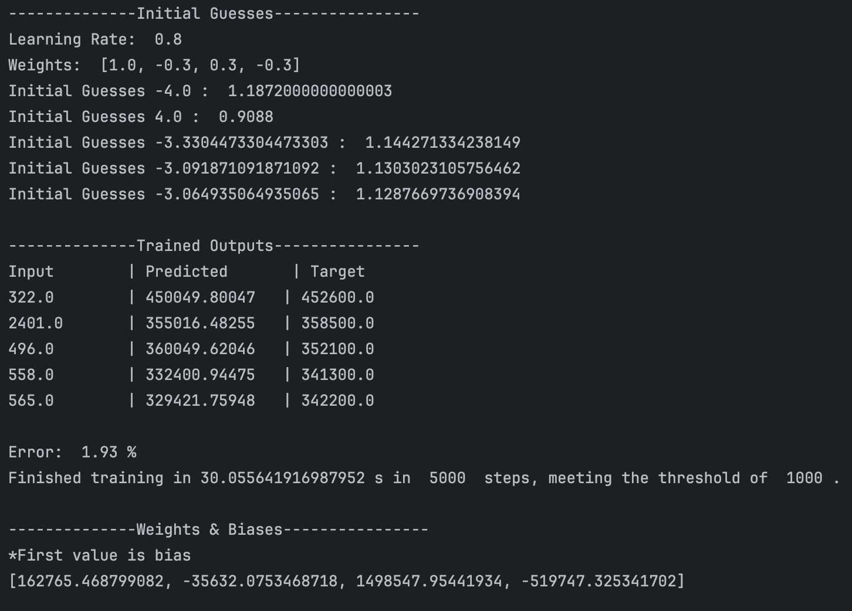
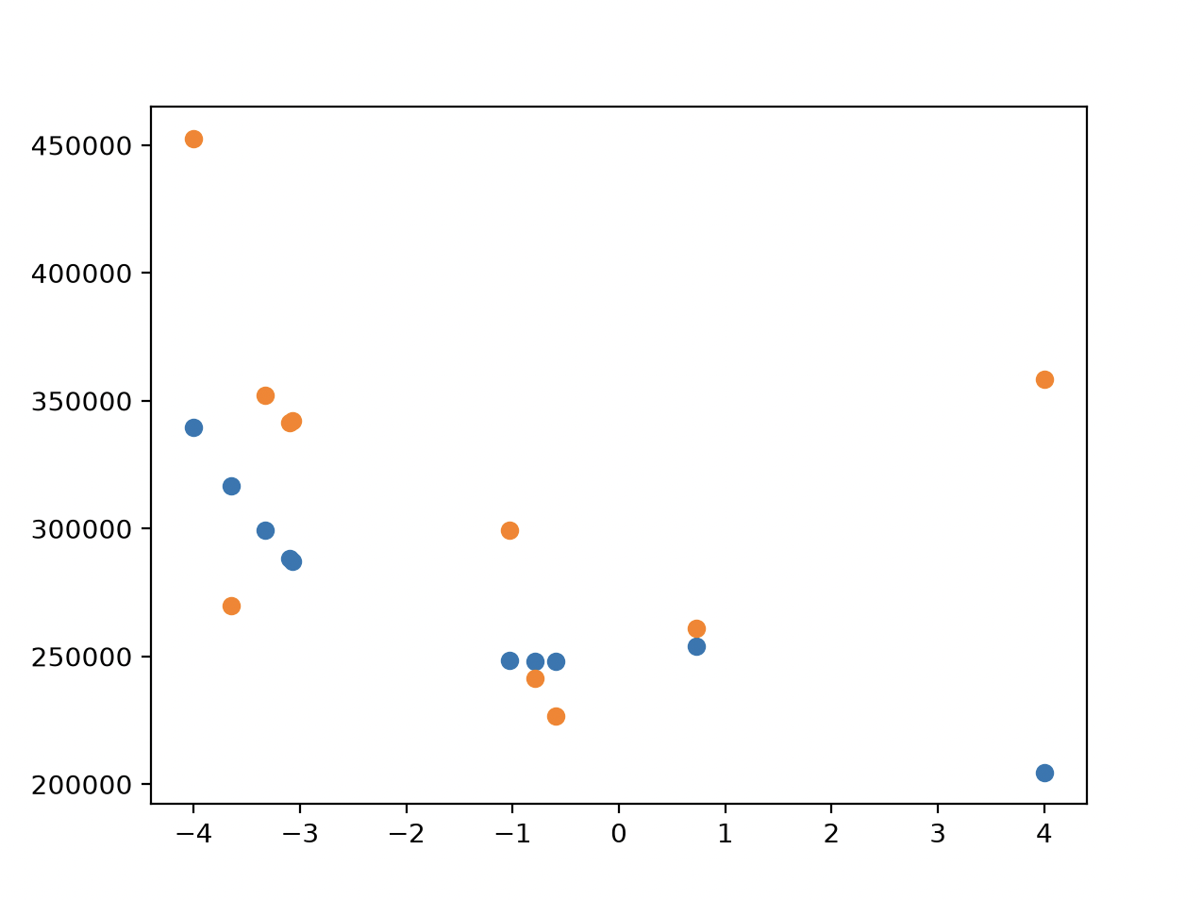
Prediction

Slide 8
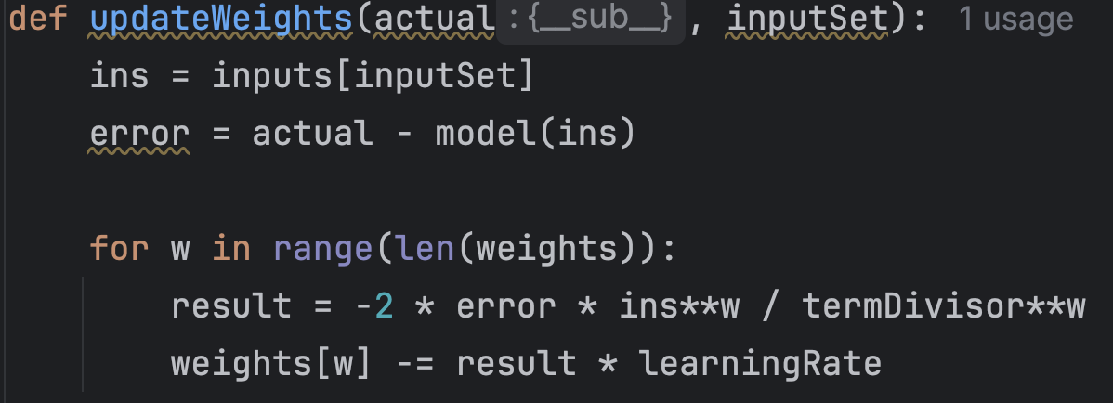
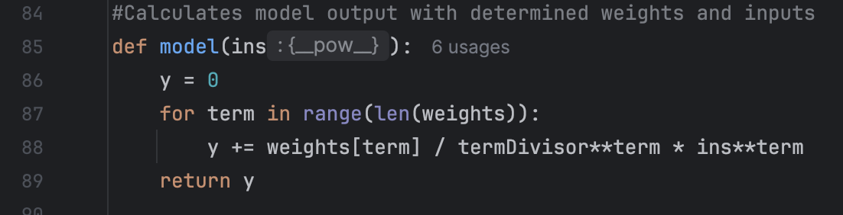
Further Developments
*After github upload
Removed symbolic derivative
  (2,416x faster)
Dynamic number of terms
UI

Slide 9
Demo

